Slide 1
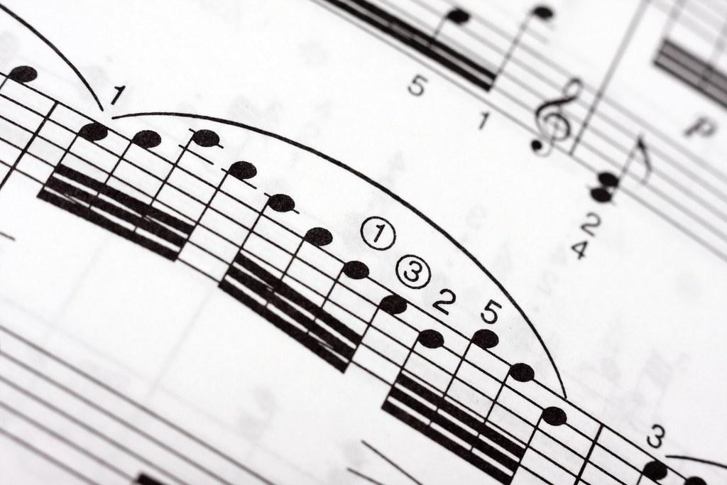
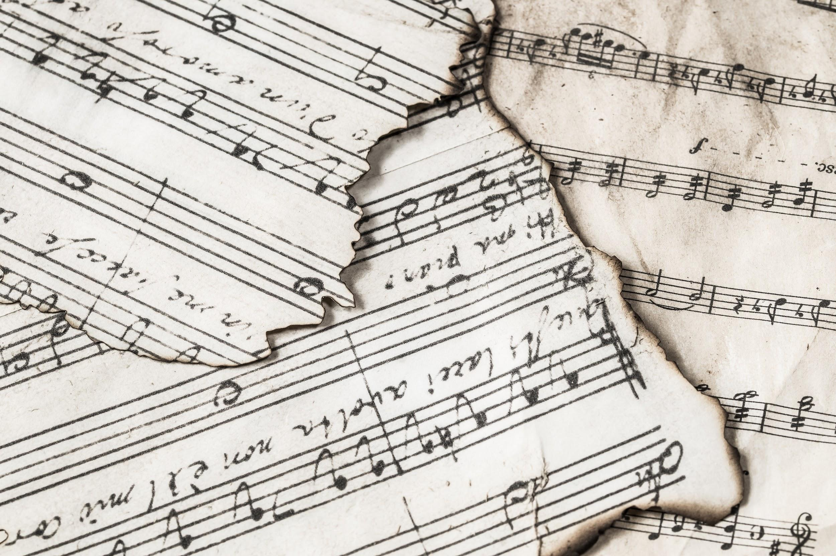
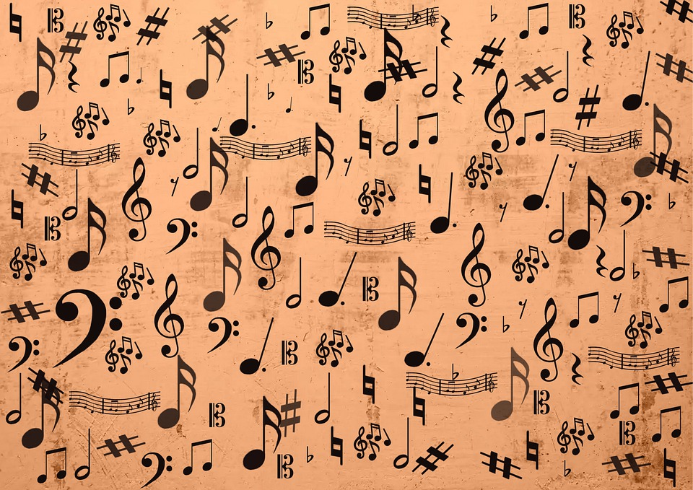
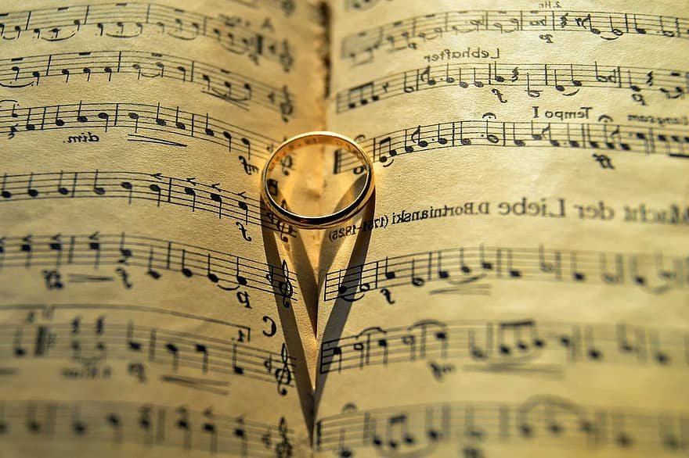
Music Timeline
Music From The Middle Ages Through 20th Century Period

Slide 2
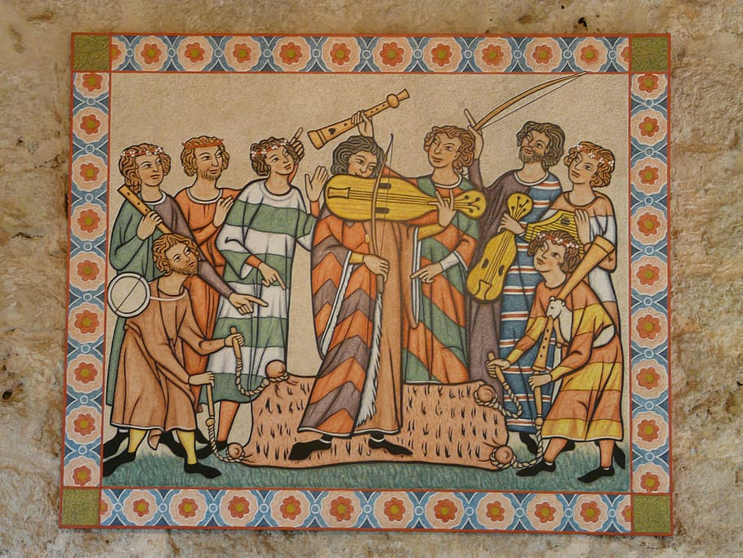
Middle Ages (476 AD - 1450 AD)

Slide 3
Middle Ages
The control over one’s own destiny was not possible. Life was difficult. As a result, people turned to God for help. This was done mainly through organization such as he Roman Catholic Church. Those that work for the church was called clery. All clergy worked in the fields and prayed in the church. All religious services started early in the mornings and continue throughout the day. The most important service was Mass, a symbolic reenactment of the Last Supper, which was celebrated nine o’clock in the morning (Wright, Chapter 4).

Slide 4
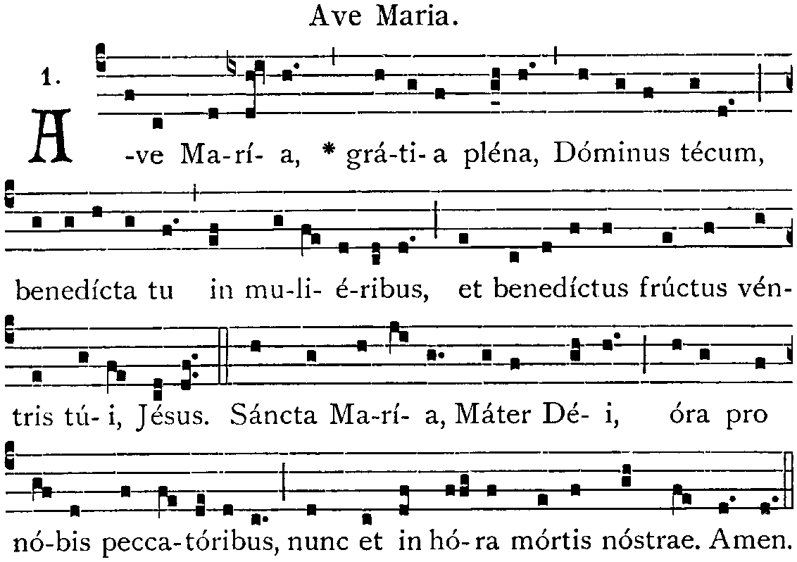
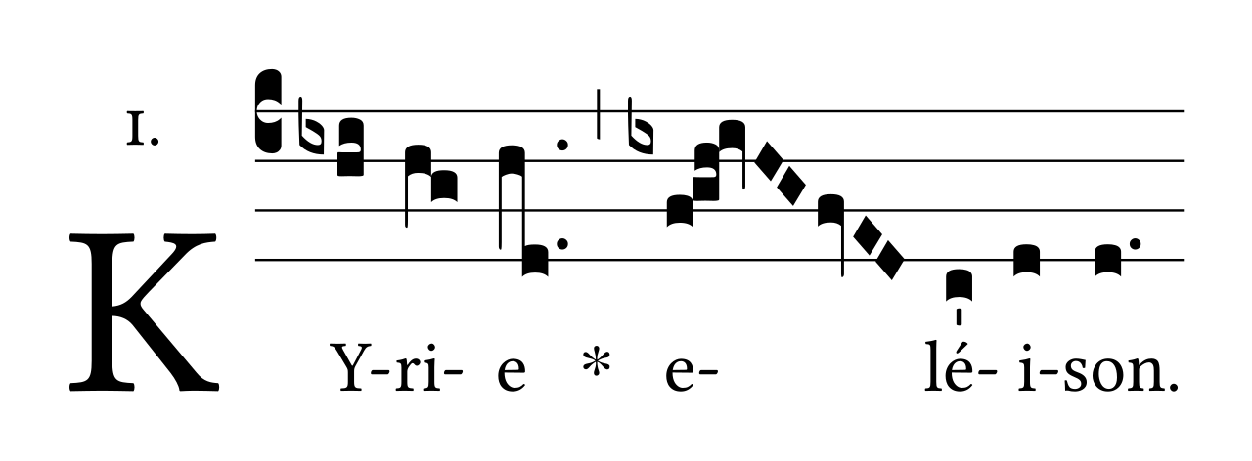
Major Music Events
540-604: Gregorian Chant was created by many people and named after Pope Gregory the Great (Wright).

Slide 5
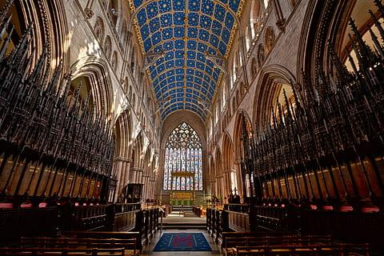
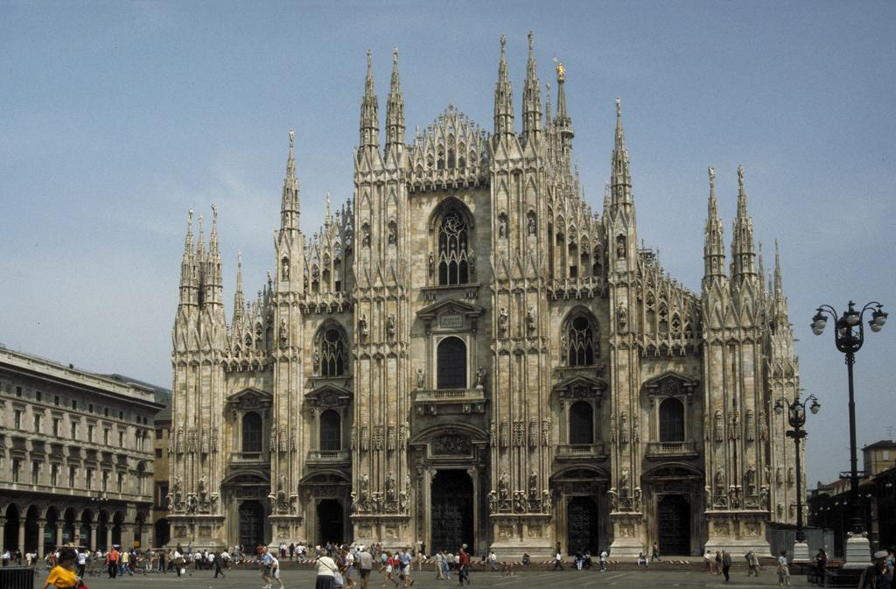
Major Music Events
1150-1350: New constructed cathedrals possessed the Gothic Style elements which possessed features such as pointed arches, high ceiling vaults, flying buttresses, and richly colored stained glass (Wright).

Slide 6
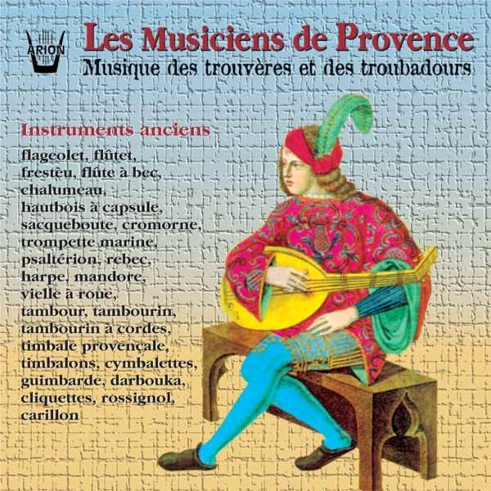
Major Music Events
1150-1400: Poet-musicians who flourished in southern France were called troubadours, and those in the north trouveres (Wright).

Slide 7
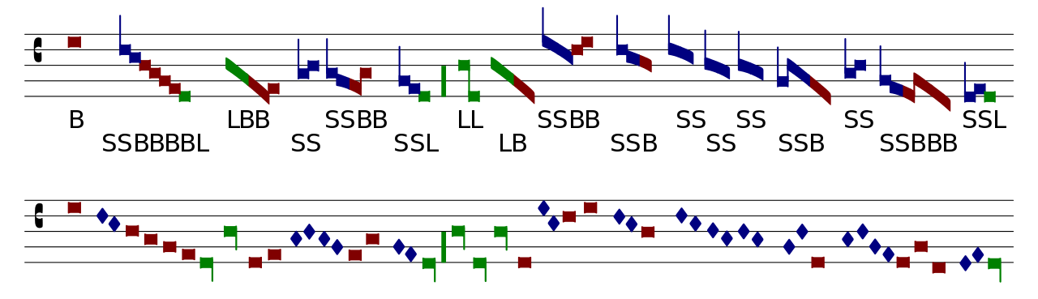
Major Music Events
1300-1400: Mensural Notation was created by musicians who wanted specify precisely musical rhythm as well as pitches (Wright).

Slide 8
Vocabularies for the Middle Ages
Mass: the central religious service of the Roman Catholic Church, one that incorporates singing for spiritual reflection or as accompaniment to sacred acts
Gregorian chant (plainsong): a large body of unaccompanied monophonic vocal music, set to Latin texts, composed for the Western Church over the course of fifteen centuries, from the time of the earliest fathers to the Council of Trent (1545–1563)
Dies irae: a Gregorian chant composed in the thirteenth century and used as the central portion of the Requiem Mass of the Catholic Church
Syllabic singing: a style of singing in which each syllable of text has only one or two notes; the opposite of melismatic singing

Slide 9
Vocabularies for the Middle Ages
Melismatic singing: many notes sung to just one syllable
Gothic style: a medieval style exemplified by cathedrals possessing such elements as pointed arches, high ceiling vaults, flying buttresses, and richly colored stained glass
Organum: the name given to the early polyphony of the Western Church from the ninth through the thirteenth centuries
Mensural notation: measured notation that specified rhythm as well as pitch precisely

Slide 10
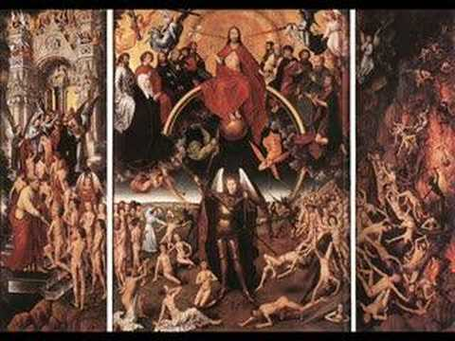
Gregorian Chant - “Dies Irae”

Slide 11
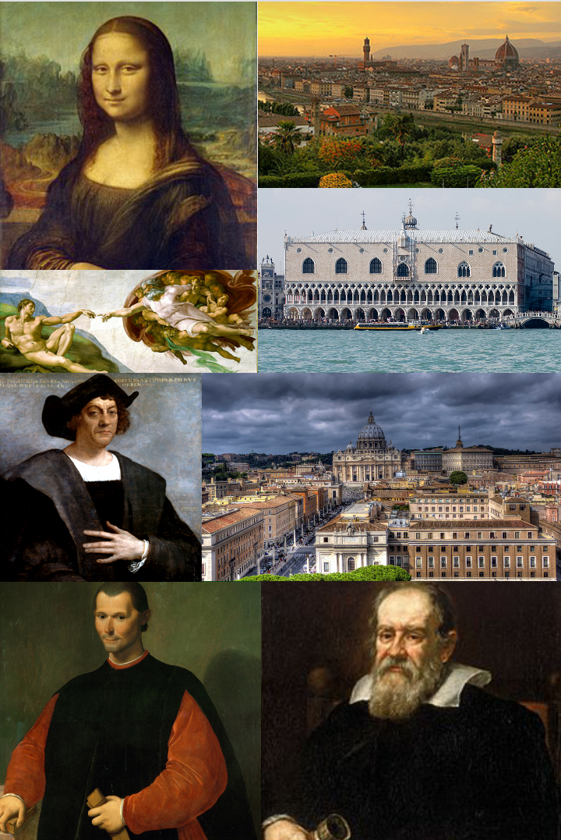
Renaissance Period (1450 AD - 1600 AD)

Slide 12
Renaissance
Renaissance was a time of “rebirth”. During this era, an individual by the name of Josquin Desprez was the greatest composers of time, the Mozart or Beethoven of his day. Composers in those days turned to the Old Testament of the Bible to continued to set the prescribed text of the Mass, especially from the books of Psalms and Lamentation. Towards the end of 1530, a new kind of popular song took Europe by surprise, a madrigal.

Slide 13
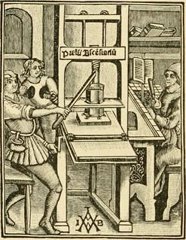
Major Music Events
1460: The invention of the printing press by Johannes Guerberg.

Slide 14
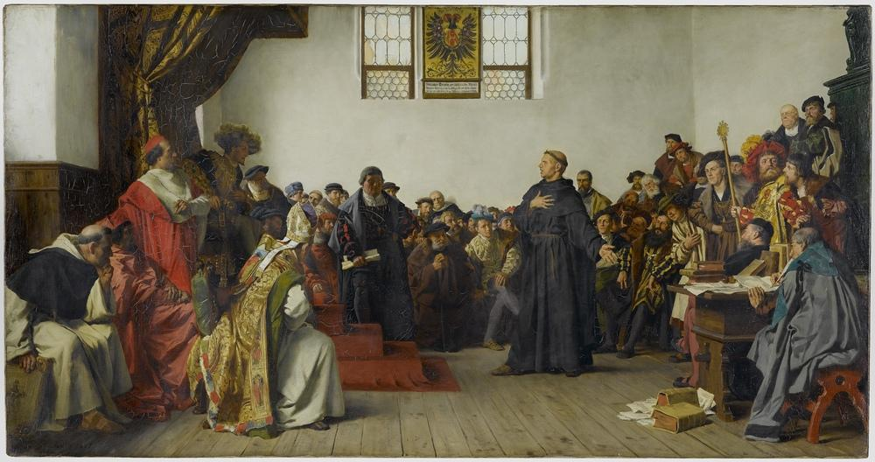
Major Music Events
1525: The Counter-Reformation, a movement that changed art, architecture, and music.

Slide 15
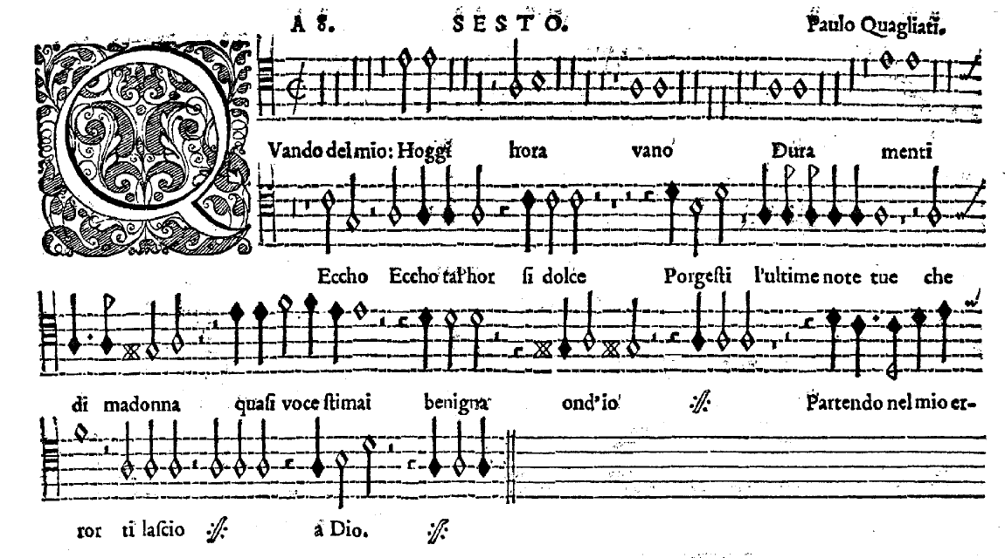
Major Music Events
1530: The Madrigal, a new king of popular and polyphonic.

Slide 16
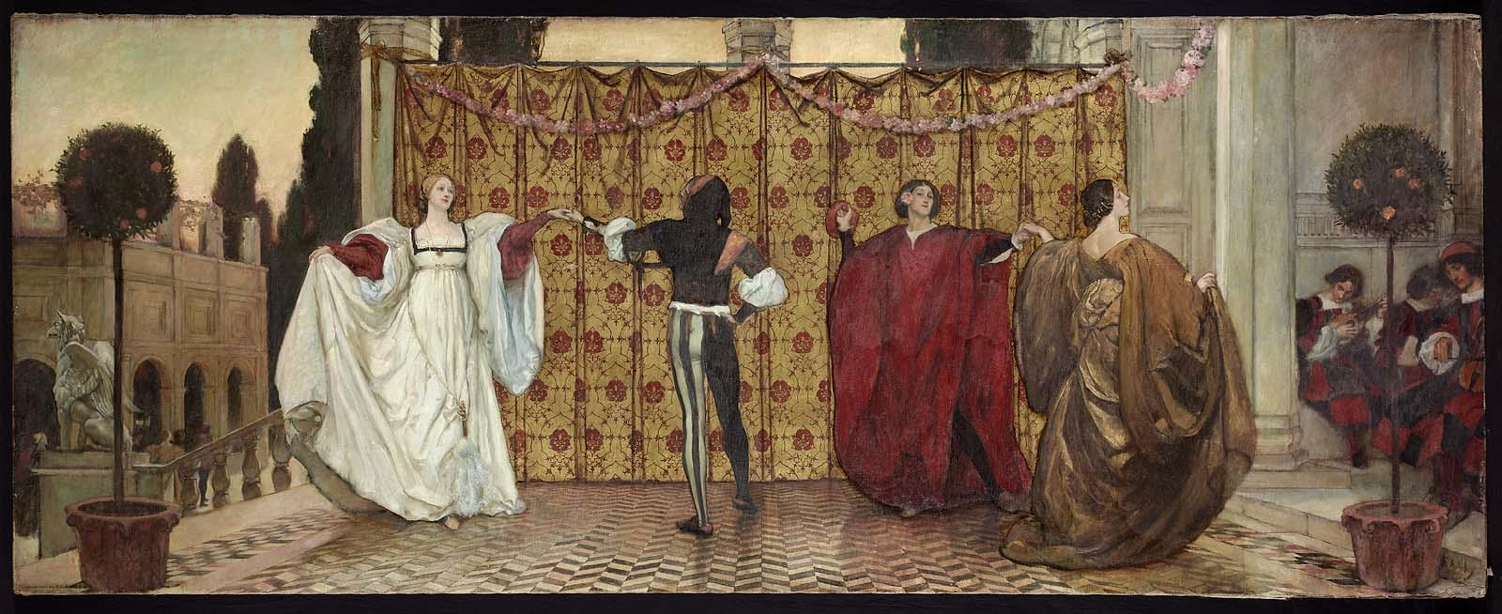
Major Music Events
1650: The most popular type of dance, the pavane.

Slide 17
Vocabularies for the Renaissance
Renaissance: period of intellectual and artistic flowering that occurred first in Italy, then in France, and finally in England, during the years 1350–1600
Counter-Reformation: a movement that fostered reform in the Roman Catholic Church in response to the challenge of the Protestant Reformation and led to a conservative, austere approach to art
Pavane: slow, gliding Renaissance dance in duple meter performed by couples holding hands
Humanism: the Renaissance belief that people have the capacity to create many things that are both good and beautiful; it rejoiced in the human form in all its fullness, looked outward, and indulged a passion for invention and discovery

Slide 18
Vocabularies for the Renaissance
Galliard: a fast, leaping Renaissance dance in triple meter
Madrigal: a popular genre of secular vocal music that originated in Italy during the Renaissance, in which usually four or five voices sing love poems
Madrigalisms: a device, originating in the madrigal, by which key words in a text spark a particularly expressive musical setting
Motet: a composition for choir or larger chorus setting a religious, devotional, or solemn text; often sung a cappella

Slide 19
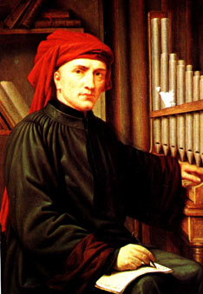
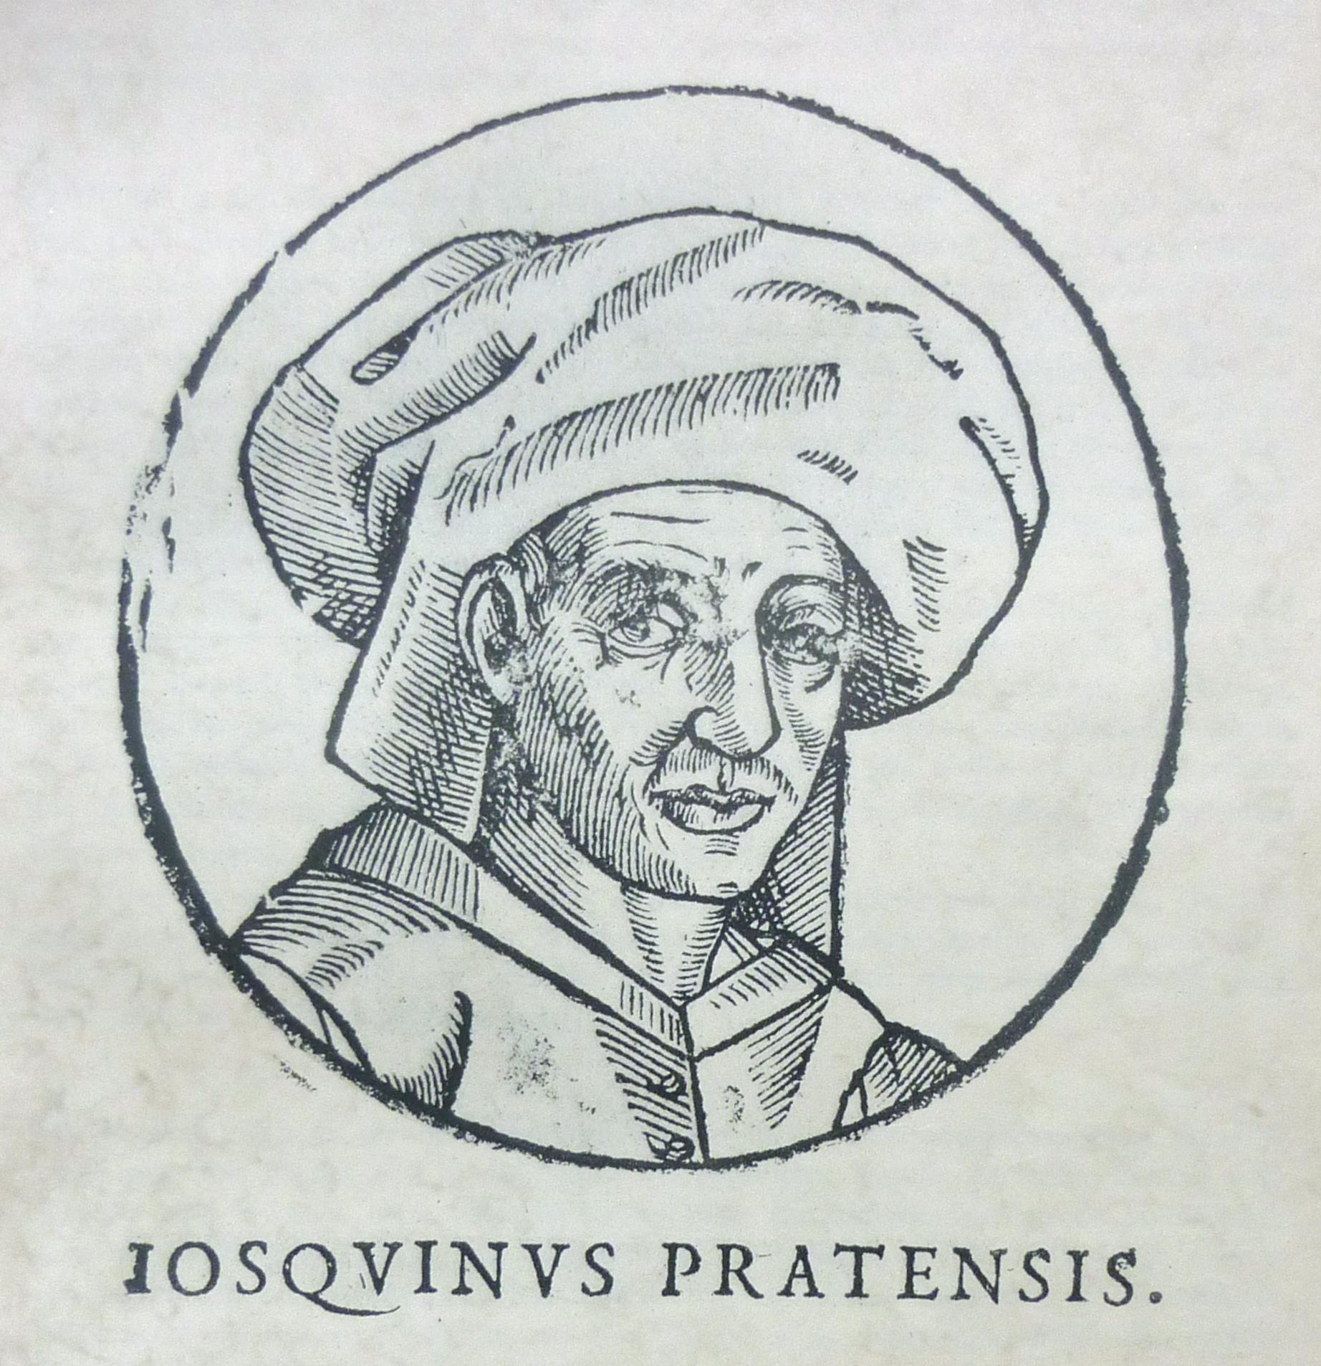
Leading Composers of the Renaissance
Josquin Desprez (1455-1504)
Pursued fame and fortune as musicians of northern France
Worked for dukes in Milan and Ferrara, and in Rome
Composed all musical genres of his day, secular as well as sacred.
A temperamental person with an egotistical personality
Wrote Ave Maria
Greatest composer of the Renaissance

Slide 20
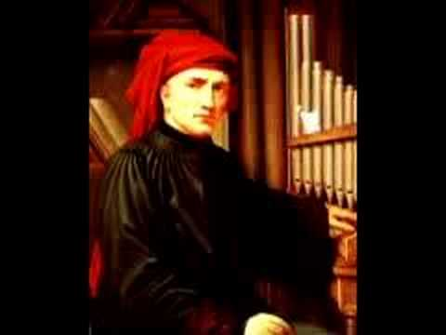
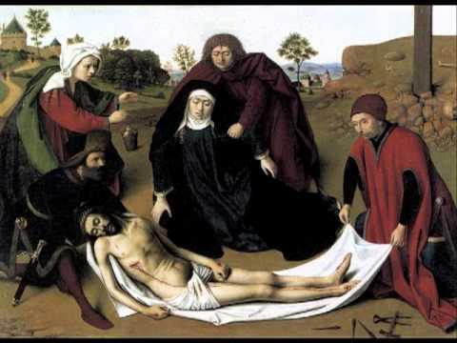
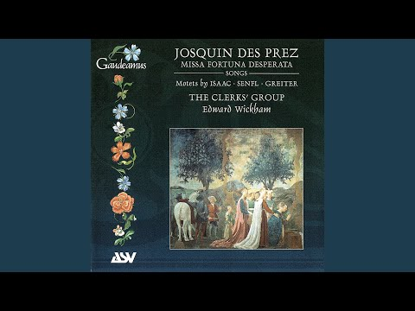
Josquin Desprez’s Music
Bergerette Savoysienne
Ave Maria
Miserere Mei Deus

Slide 21
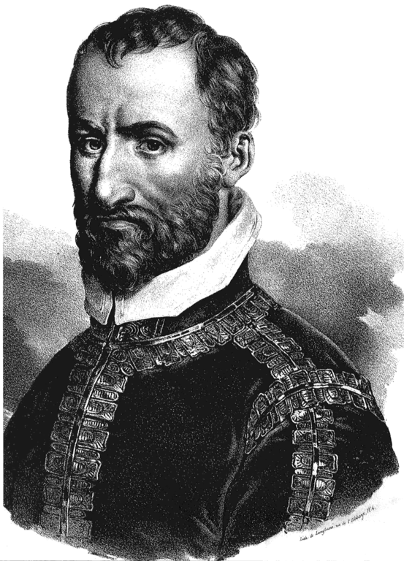
Leading Composers of the Renaissance
Giovanni Pierluigi da Palestrina (1525-1594)
First composer of the church to have been a layman rather than a cleric
Composed Kyrie of the Missa Papae Marcelli (1555)
Became known as the “savior of church music”
The fathers of the Council of Trent saw his somber, serene style of religious music as a useful vehicle to inspire the faithful to greater devotion.

Slide 22
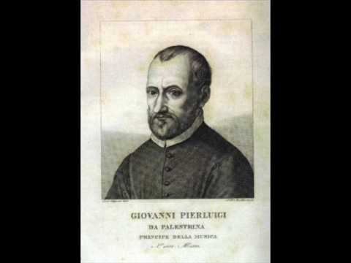
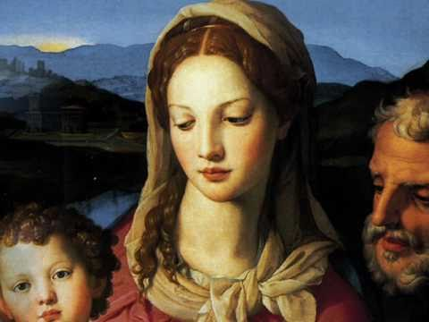
Giovanni Pierluigi da Palestrina’s Music
Missa Papae Marcelli
Vergine Bella

Slide 23
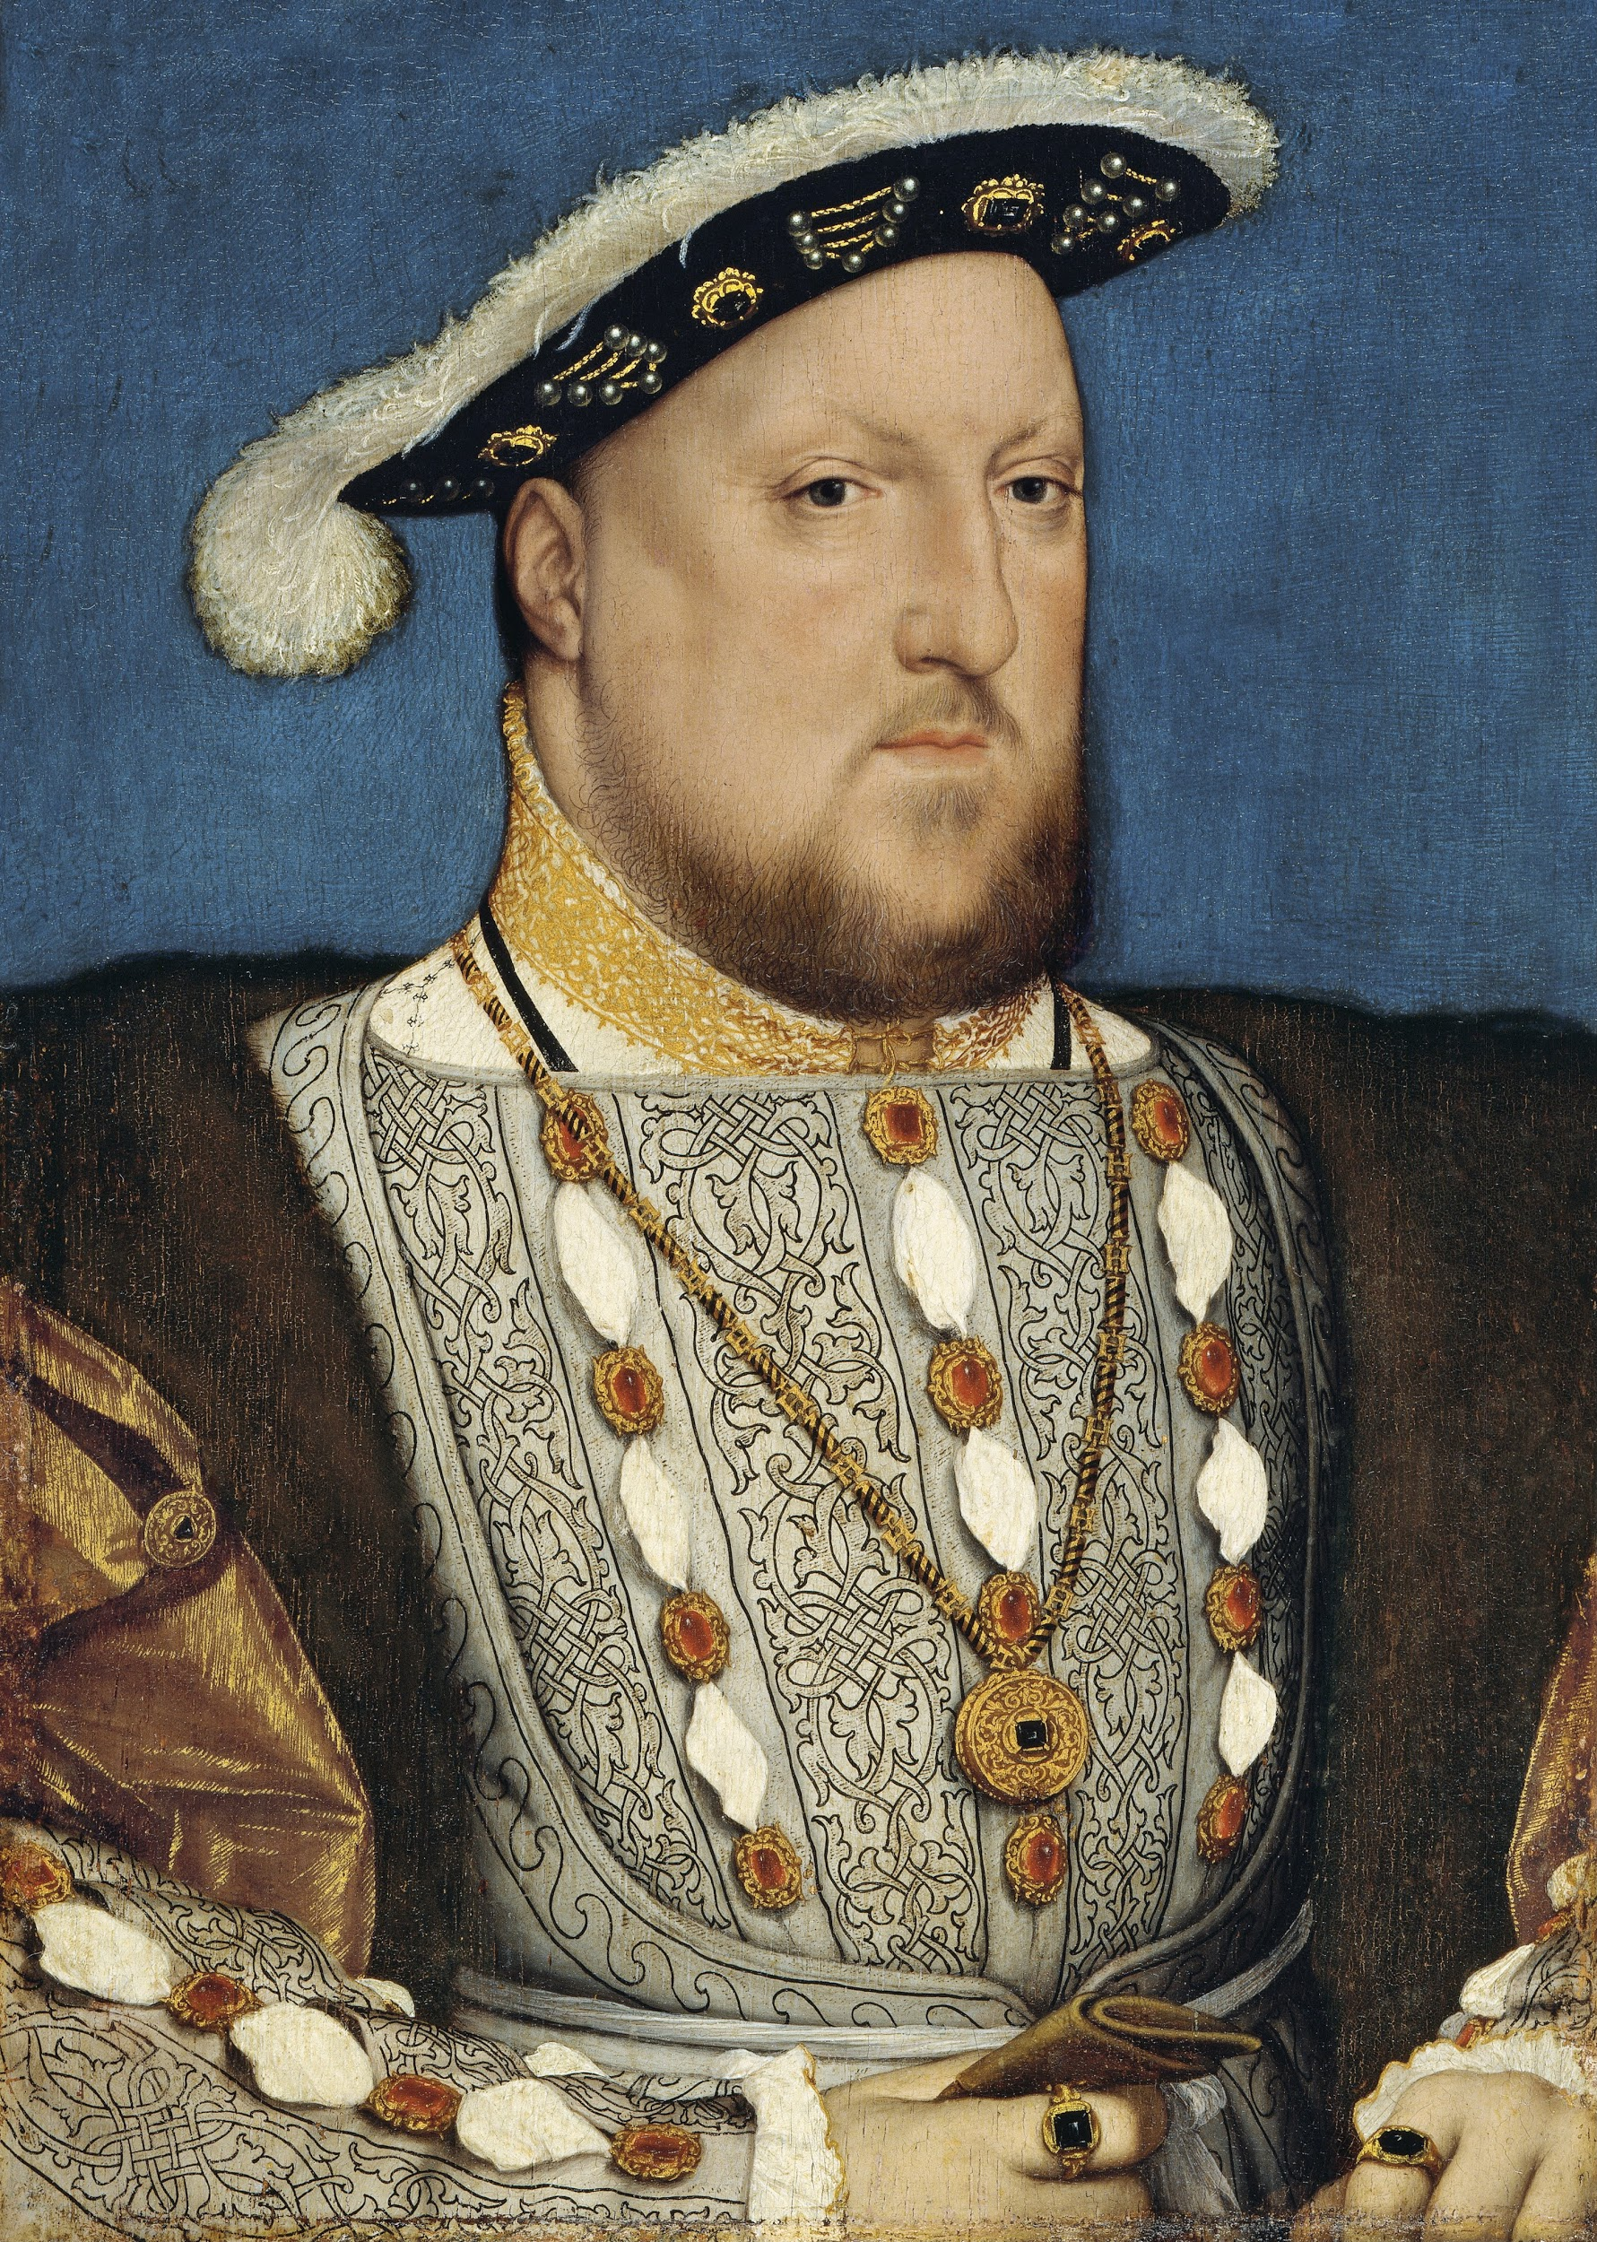
Leading Composers of Renaissance
Thomas Weelkes (1576-1623)
Published twenty-four madrigals in honor of Virgin Queen Elizabeth.
His madrigals were popular because they were fun to sing.

Slide 24
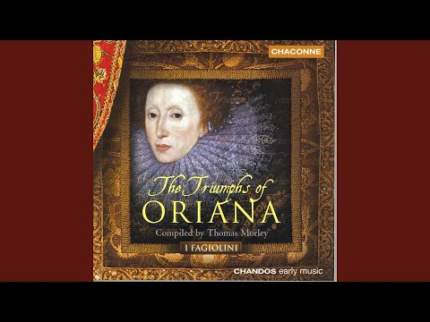
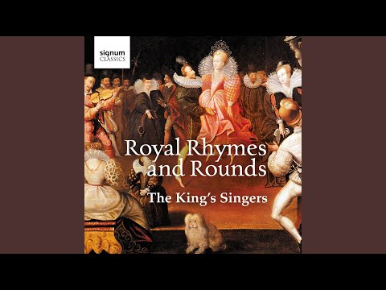
Thomas Weelkes’ Music
As Vesta Was from Latmos Descending
The Triumphes of Oriana

Slide 25
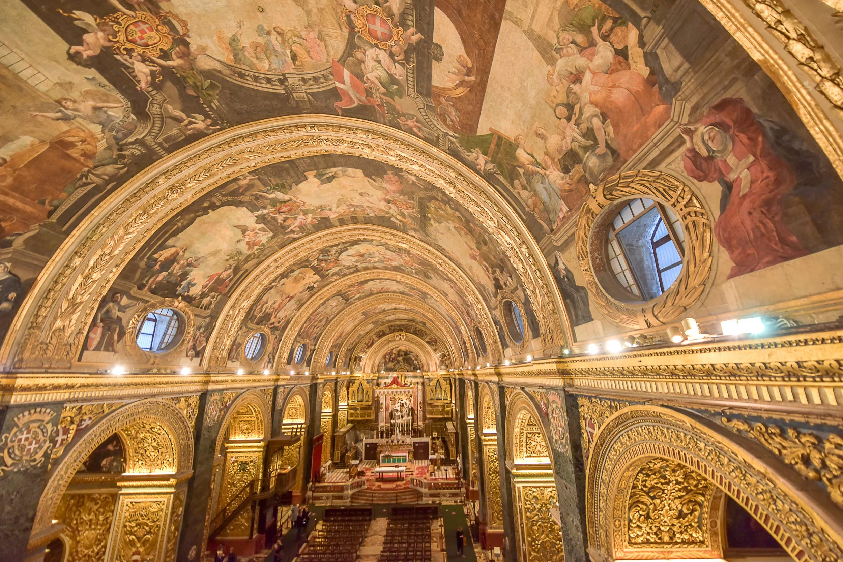
Baroque Period (1600 - 1750)

Slide 26
Baroque Period
Baroque music took place in Italy in the early seventeenth century. Arts associated greatly with music during this period, to the point that critics used the term baroque to point out the extreme ornamentation in the visual arts and the irregular, bold instrumental sound in melody and tune. This did gave the music of this era a different and negative feel to it that presented “distortion, excess, and extravagance” to some; however, painter Peter Paul Rubens and composer J.S Bach, along with some others, contributions gave the term baroque a positive meaning in Western cultural history. Music during the Baroque period was hold in large buildings marked with tisted column and curving shapes, color, and movement. Baroque canvases are extremely large and colorful, overly dramatic. There were much religious wars between the Protestants and Catholics. Exploration and colonization of the new world took place during this period as well.

Slide 27
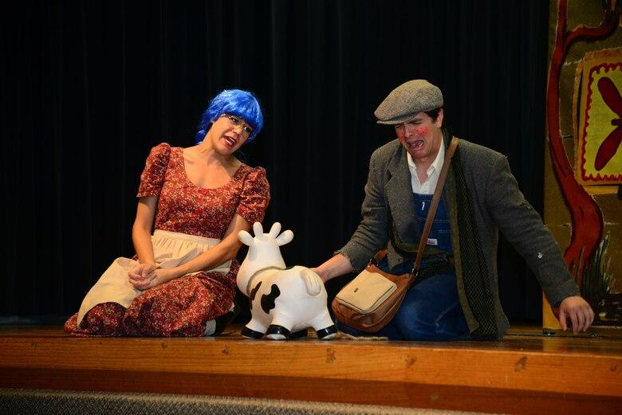
Major Music Events
Around 1600: Opera appeared in Europe.

Slide 28
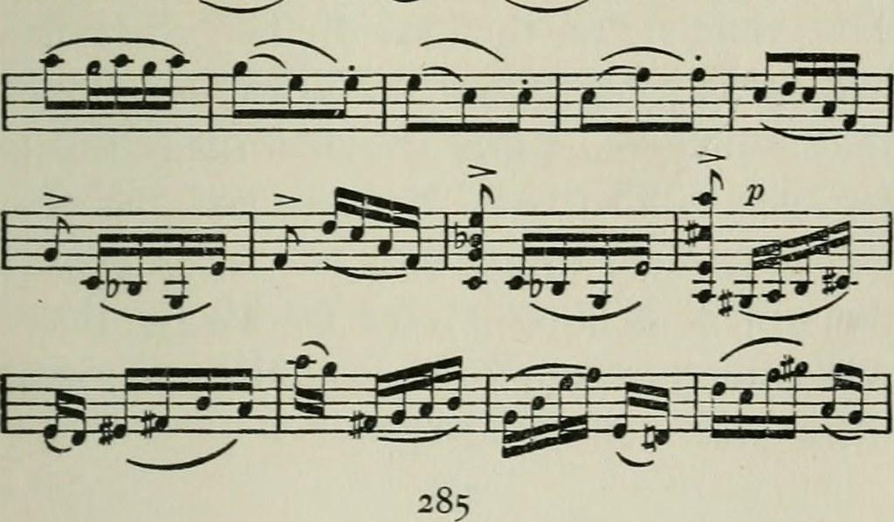
Major Music Events
Around 1700: The composition of Idiomatic Writings.

Slide 29
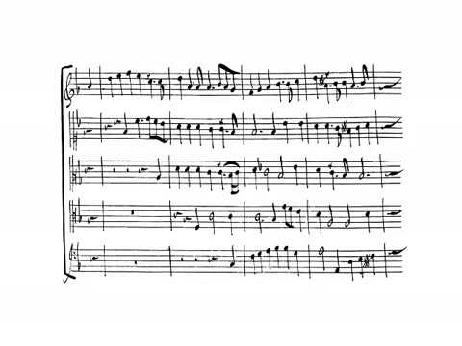
Major Music Events
Around 1700: The French Overture, greatest gift from King Louis to music.

Slide 30
Vocabularies for the Baroque Period
Baroque: term used to describe the arts generally during the period 1600–1750 and signifying excess and extravagance
Basso Continuo: a small ensemble of at least two instrumentalists who provide a foundation for the melody or melodies above; heard almost exclusively in Baroque music
Solo Concerto: a concerto in which an orchestra and a single performer in turn present and develop the musical material in the spirit of harmonious competition
Melodic Sequence: the repetition of a musical motive at successively higher or lower degrees of the scale

Slide 31
Vocabularies for the Baroque Period
Fugue: a composition for three, four, or five parts played or sung by voices or instruments; begins with a presentation of a subject in imitation in each part and continues with modulating passages of free counterpoint and further appearances of the subject
Chorale: the German word for the hymn of the Lutheran Church; hence, a simple religious melody to be sung by the congregation
Opera seria: a genre of opera that dominated the stage during the Baroque era, making use of serious historical or mythological subjects, da capo arias, and lengthy overtures
Dance Suite: a collection of instrumental dances, each with its own distinctive rhythm and character

Slide 32
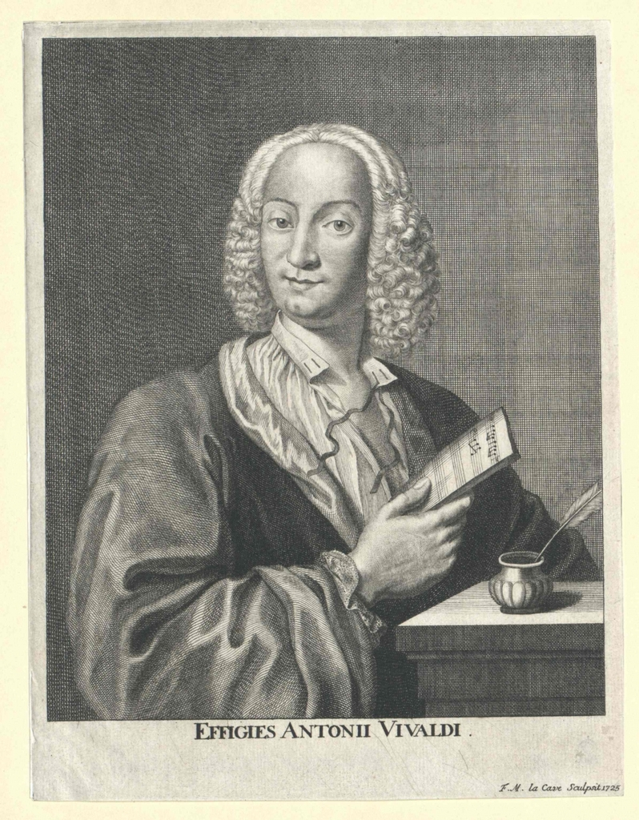
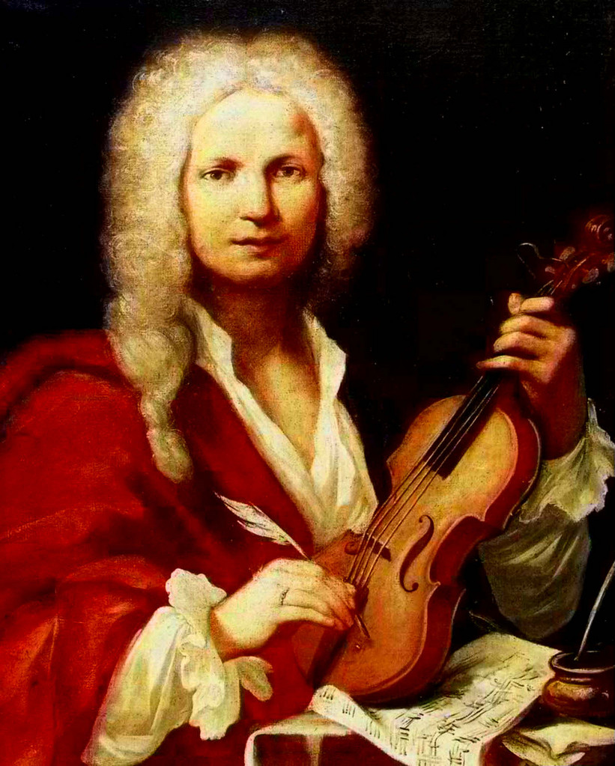
Leading Composers of the Baroque Period
Antonio Vivaldi (1678-1741)
Most influential and prolific composer in the creation of the Baroque concerto.
Compose and wrote early fifty operas.
Ordained priest
Played violin
Lived fifteen years with an Italian opera star.
Worked in Venice at the Ospedale della Peita (Hospice of Mercy) from 1703 until 1740.

Slide 33
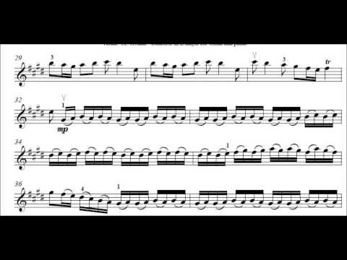
Antonio Vivaldi’s Music
Violin Concerto in E major
(the “Spring,” early 1700s

Slide 34
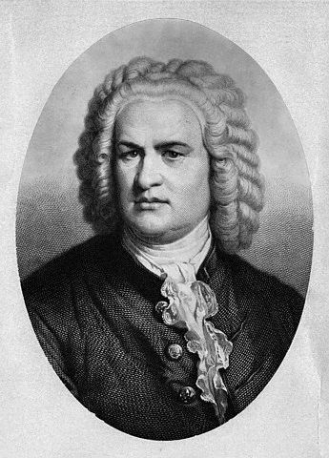
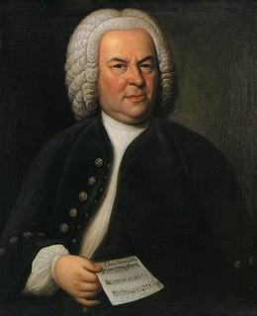
Leading Composers of the Baroque Period
Johann Sebastian Bach (1685-1750)
Johann Sebastian was part of Bach, a brand name and the longest of all musical dynasties.
Most gifted and talented member of the organization.
Learned his trade on his own by studying, copying, arranging the compositions of Vivaldi, Pachelbel, and Palestrina.
Most well-known organ virtuoso in Germany
In 1732, moved to German city of Leipzig and took on the coveted position of St. Thomas church and choir school.
Devoted husband and a loving father to twenty children.
Composed his music not for self-expression, but for is his Lutherans and for God’s glory.

Slide 35
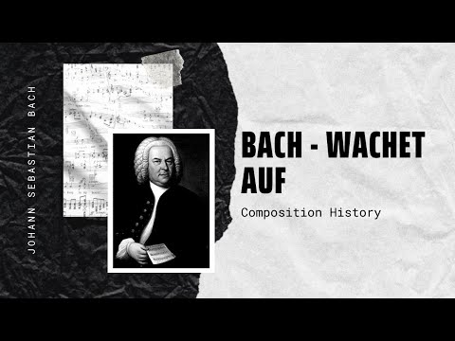
Johann Sebastian Bach’s Music
Wachet auf, ruft uns die Stimme (1731)

Slide 36
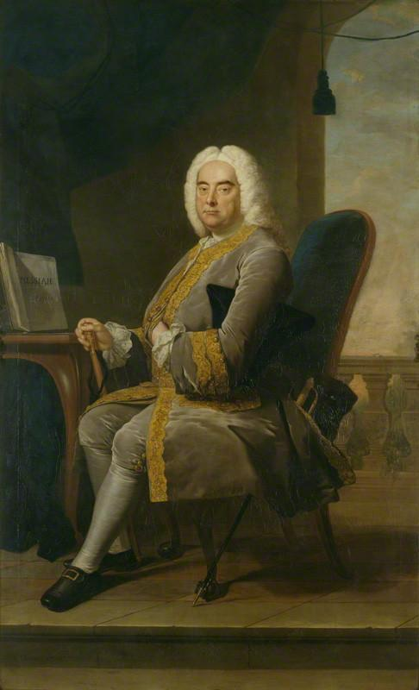
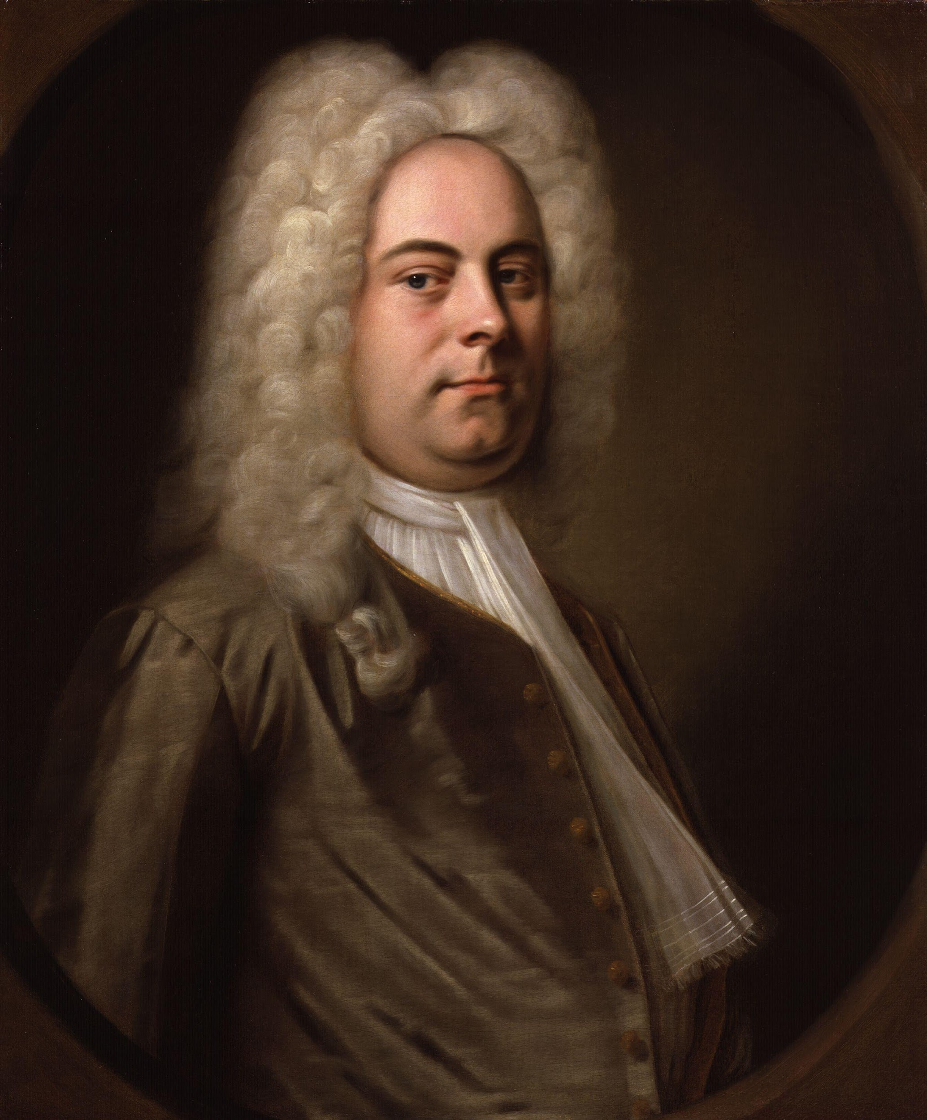
Leading Composers of the Baroque Period
George Frideric Handel (1685-1759)
George Frideric Handel is known for being the most famous composer in Europe. Growing up, his father had demanded that he pursued a trade in laws. Though this was what his father’s wanted for him, Handel, slowly grew toward the interest in music.
At age eighteen, Handel pursued his music education in Italy. He was educated at University of Halle.
After ten years in Italy, Handel returned to Germany and accepted a music director position for the Elector of Hanover.

Slide 37
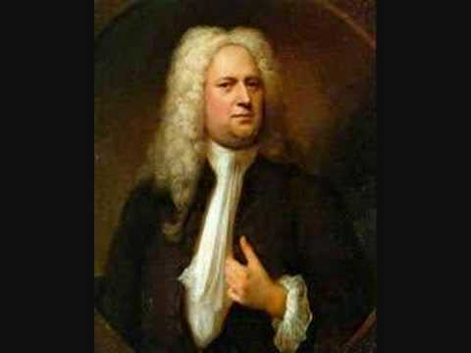
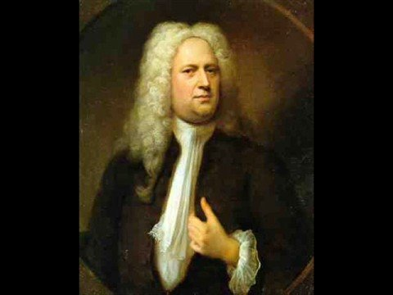
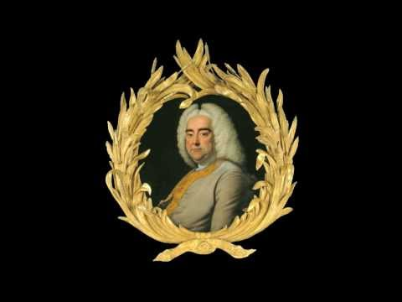
George Frideric Handel’s Music
Music for the Royal Fireworks
(1749)
Water Music (1717)
Messiah (1741)

Slide 38
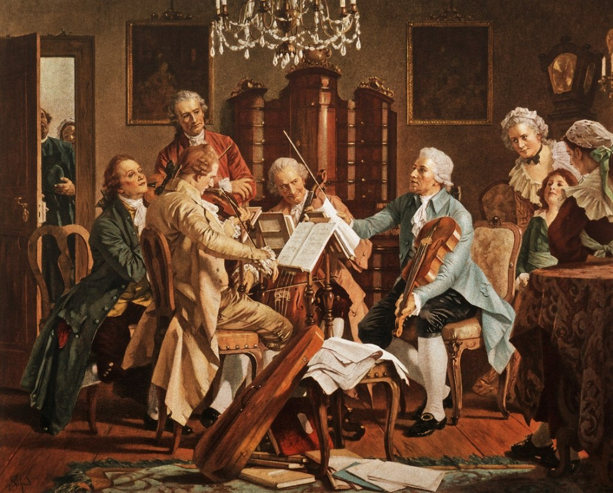
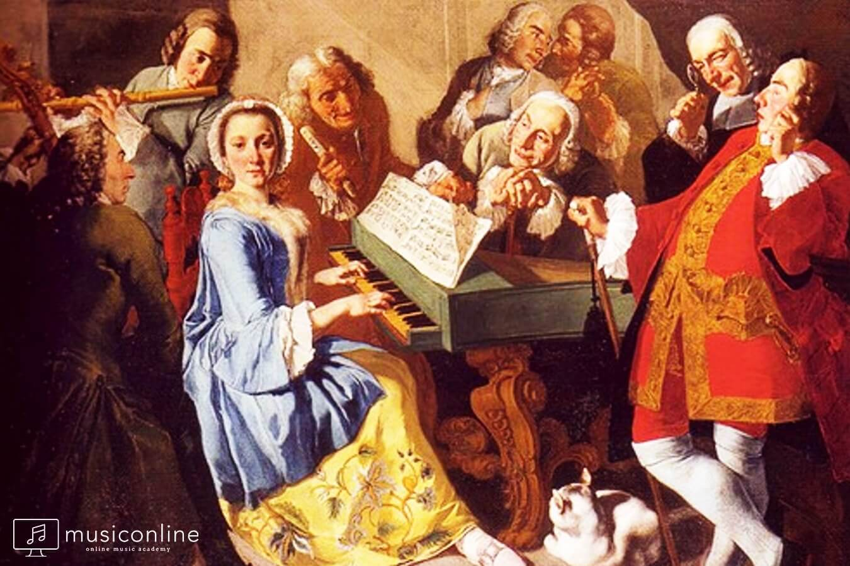
Classical Period (1750 - 1820)

Slide 39
Classical Period
Classical period overlaps with the period in philosophy knowns as Enlightenment. During this time, thinkers gave free rein to the pursuit of truth and the discovery of natural laws, which was formulated by Isaac Newton. Fashion changed dramatically in this era. Sophisticated men powdered their faces and wore elaborate wigs. Middle class people did not just want to attend concerts and operatic performance. They wish gain revenue from with own music played at home. The invention of the piano slowly replaced the harpsichord and became the primary domestic music. The creations of Classical style would be from Mozart and Haydn while the expansion of it through Beethoven’s work.

Slide 40
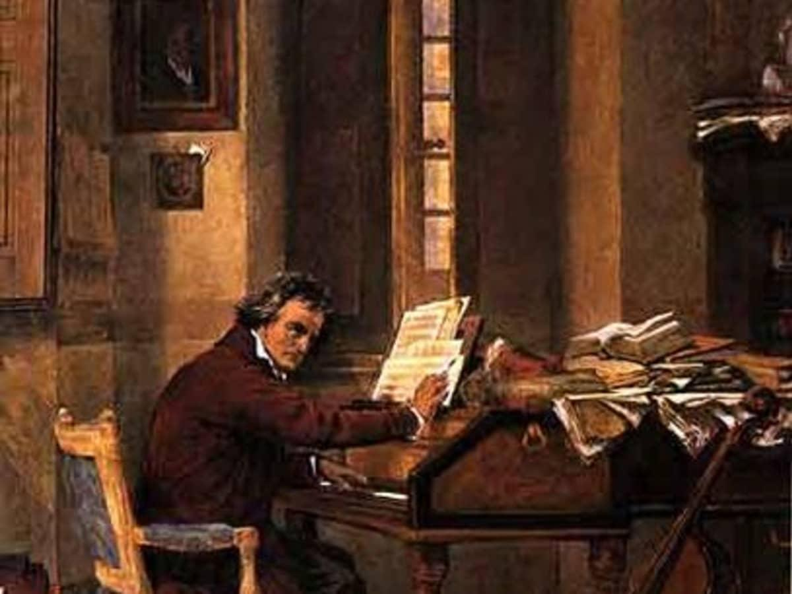
Major Music Events
Around 1700: The invention of the piano.

Slide 41
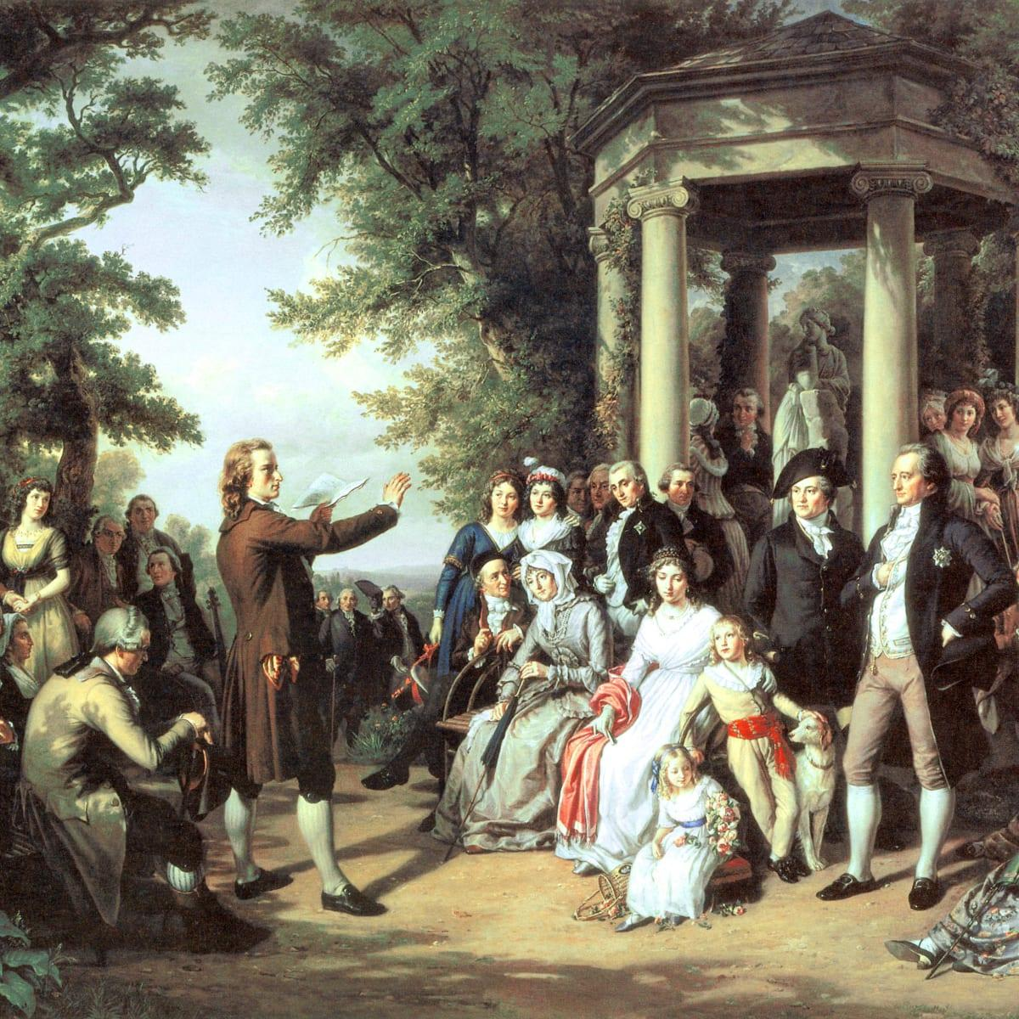
Major Music Events
Around 1750: The start of Enlightenment, the Age of Reason.

Slide 42
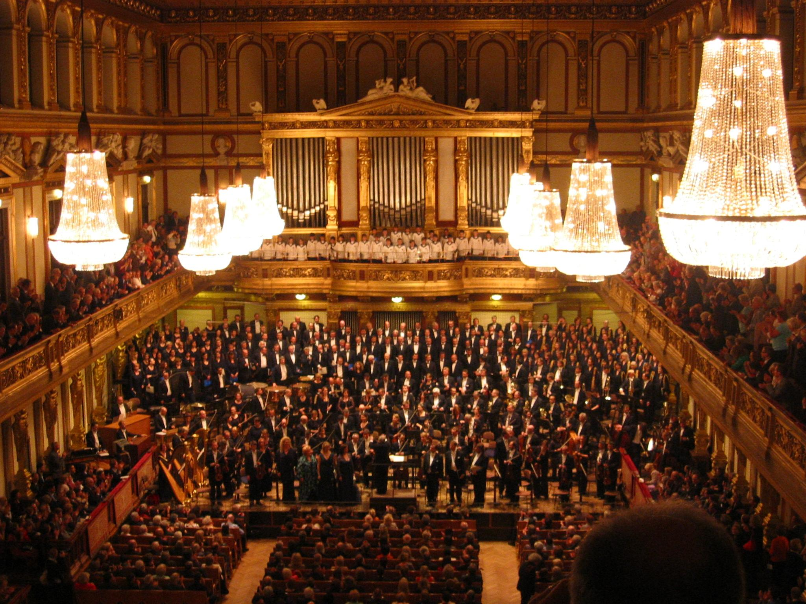
Major Music Events
Around 1750: The Democratization of Classical Music and the Rise of “For Profit” Concerts.

Slide 43
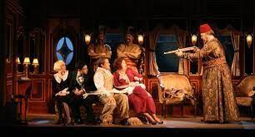
Major Music Events
Around 1800: Comic opera appeared.

Slide 44
Vocabularies for the Classical Period
Opera Buffa: (Italian for “comic opera”) a genre of opera featuring light, often domestic subjects, with tuneful melodies, comic situations, and happy endings
Comic Opera: a genre of opera that originated in the eighteenth century, portraying everyday characters and situations, and using spoken dialogue and simple songs
Antecedent Phrases: the opening, incomplete-sounding phrase of a melody; often followed by a consequent phrase that brings the melody to closure
Sonata–Allegro form: a dramatic musical form that originated in the Classical period involving an exposition, development, and recapitulation, with optional introduction and coda

Slide 45
Vocabularies for the Classical Period
Rondo: classical form with at least three statements of the refrain (A) and at least two contrasting sections (at least B and C); placement of the refrain creates symmetrical patterns such as ABACA, ABACABA, or even ABACADA
Sonata: originally, “something sounded” on an instrument as opposed to something sung (a “cantata”); later, a multi-movement work for solo instrument, or instrument with keyboard accompaniment
Singspiel: (German for “singing play”) a musical comedy originating in Germany with spoken dialogue, tuneful songs, and topical humor
Scherzo: (Italian for “joke”) a rapid, jovial work in triple meter often used in place of the minuet as the third movement in a string quartet or symphony

Slide 46
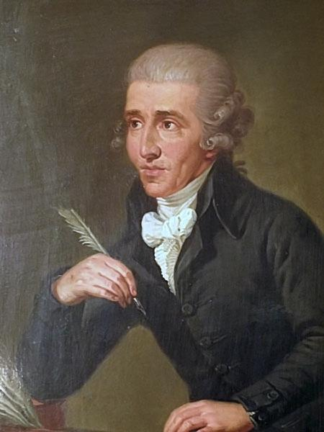

Leading Composers of the Classical Period
Franz Joseph Haydn (1732 - 1809)
Haydn was the first of the great Classical composer to relocate to Vienna. Born in a farmhouse in Rohraus, Sutria, Haydn sung sorano as a boy and studied rudiments of composition, violin, and keyboard at a young age. In 1761, he became director of music for the court of Prince Nikolaus Esterhazy served thirty years. Haydn wrote twelve symphonies called the London Symphonies.

Slide 47


Franz Joseph Haydn’s Music
Symphony No. 94, the “Surprise” Symphony (1791)
Trump Concerto in Eb major (1796)

Slide 48

Franz Joseph Haydn’s Music
String Quartet, Opus 76, No. 3, the “Emperor” Quartet (1797)

Slide 49


Leading Composers of the Classical Period
Wolfgang Amadeus Mozart (1756 - 1791)
Mozart was borned in the mountain town of Salzburg, Austria. His father was a violinist in the orchestra of archbishop of Salzburg. By age six, Mozart played the piano, violin and organ. He was terrified by the sound of trumpet and the sound of out-of-tune instruments brought physical pain to his ear until age of ten. Mozart was the most universal composer in the history of Western music. Mozart’s great memory and power of concentration allowed him to composed numbermous masterpieces.

Slide 50



Wolfgang Amadeus Mozart’s Music
Piano Concerto in C major (1786), K. 467
Eine kleine Nachtmusik (1787)
Don Giovanni (1787), K. 527

Slide 51



Wolfgang Amadeus Mozart’s Music
Overture to Don Giovanni (1787)
Variations on “Twinkle, Twinkle, Little Star”
Piano Concerto in A Major (1786), K. 488

Slide 52

Leading Composers of the Classical Period
Ludwig van Beethoven (1770 - 1827)
Beethoven came from a family of Musicians. His father forced him to practice the piano at all hours. Beethoven’s father tried to exploit his son as the second Mozart. In the late 1790, Beethoven first complained about his hearing and ringing in his ear, which lead him to depression. By 1814, he lost his hearing altogether. When Beethoven die, over 20,000 citizens of Vienna attended his funeral. School closed, and the army was called to control the crowd.

Slide 53

Leading Composers of the Classical Period
Ludwig van Beethoven (1770 - 1827)
Beethoven is considered a crossover composer because of his relentless pursuit in creating music as an expression of art. His music communicated universal truth about the struggle of human beings. He composition is full of extremes such as sometimes tender and sometime violent. Beethoven had shown how personal expression might push against and break free of the confines of Classical form. This is what makes him a crossover composer.

Slide 54


Ludwig van Beethoven’s Music
Piano Sonata, Opus 13, the “Pathétique” Sonata (1799)
Symphony No. 5 in C minor (1808)

Slide 55

Ludwig van Beethoven’s Music
Ode to Joy from Symphony No. 9 in D Minor (1824)

Slide 56


Romanticism Period (1820 - 1900)

Slide 57
Romanticism Period
The Romanticism Period was a time were artists set aside the tradition of Classical style and embraced a new genre. The theme “love” held a dominating influence during this period. Artists expressed their emotions, feelings, and ideas freely and openly through their art and music. Romantic artists convey individual personal feeling in their art and music in this period. Melodies in romanticism moves beyond Classical forms to longer, rhythmically flexible and irregular in shape. The music in this era was marked by hopelessness, wild behavior, and elevating happiness.

Slide 58

Major Music Events
Around 1800: Franz Schubert created a song cycle.

Slide 59

Major Music Events
Around 1800: Creation of the chromatic harmony.

Slide 60

Major Music Events
Early 1900: Ballet

Slide 61
Vocabularies for the Classical Period
Romanticism: A movement in the arts and ideas, roughly coinciding with the nineteenth century, that valued human independence, political freedom, a love of nature, and passionate expression, especially in poetry and music
Ballad: a traditional song, or folksong, sung by a soloist, which tells a dramatic, usually tragic, tale and is organized by stanzas
Orchestral song (or orchestral Lied): a genre of music emerging in the nineteenth century in which the voice is accompanied not merely by a piano but by a full orchestra
Sustaining pedal: the rightmost pedal on the piano; when it is depressed, all dampers are removed from the strings, allowing them to vibrate freely

Slide 62
Vocabularies for the Classical Period
Recital: a concert of chamber music, usually for a solo performer
Verismo opera: “realism” opera; the Italian term for a type of late-nineteenth-century opera in which the subject matter concerns the unpleasant realities of everyday life
Realistic opera: a general term for those operas of the nineteenth and early twentieth centuries that deal with everyday, gritty subjects; includes Italian verismo opera
Double stops: a technique applied to string instruments in which two strings instead of just one are pressed down and played simultaneously

Slide 63

Leading Composers of the Romanticism Period
Franz Schubert (1797 - 1828)
Born in Vienna, his father was a schoolteacher and this groomed Franz for his music career. His father taught him violin. At age eleven, Franz joined the choirboy in the emperio’s chapel. In 1812, his voice changed and eventually left the court chapel. After some schooling and teaching, he pursued his music passion. Schubert was a child prodigy much like Mozart. This is seen in his composition of Erlkonig. After reading a book of poetry by Johann von Goethe, in one setting Schubert wrote Erlkonig, including with all of it’s Goethe's ballad.

Slide 64

Franz Schubert’s Music
Erlkonig (1815)

Slide 65

Leading Composers of the Romanticism Period
Clara Wieck Schumann (1819 - 1896)
Clara Wieck Schumann was a great pianist of the nineteenth century. Married to Robert Schumann, Clara is a mother to eight children. Self-doubt made things difficult for Clara as she question the capacity of any women to be a proficient creative artist. Her most productive period as a composer was in her early years of marriage with Robert. After Robert’s death, she outlived him by forty years. She never again composed nor remarried after Robert’s death. Clara dress in black mourning while she toured. She performed across Europe into the 1890s.

Slide 66

Clara Wieck Schumann’s Music
Liebst du um Schönheit (1841)

Slide 67

Leading Composers of the Romanticism Period
Peter Tchaikovsky (1840 - 1893)
Peter Tchaikovsky was born to an upper-middle-class family in Russia. He had a natural ear for music and was able to speak both French and German fluently at age six. He was less of a motivic composer and more a musical narrator. Peter excelled at program music because of this. He always had a story to tell in this music. In 1866, He graduated from college and worked at Moscow Conservatory as a professor of harmony and musical composition.

Slide 68


Peter Tchaikovsky's Music
Romeo and Juliet (1869)
Dance of the Reed Pipes (1891)

Slide 69

20th Century Period (1880 - Present)

Slide 70
20th Century Period
This was an era where composers used a varieties of musical styles such as electronic music, chance music, and Minimalism. Any one person could created and applied whatever artistic methods and values he or she liked. Musical Impressionism was created by the French during this period. This was middle ground between the sounds of Romanticism and Modernism. Sound produced in modern and postmodern period had the capacity to transported one’s mind into a distant land to experience striking and unusually feelings.

Slide 71

Major Music Events
In 1908: Creation of atonal music by Arnold Schoenberg.

Slide 72

Major Music Events
From 1920 until 1951: Development of Neo-classicism by Igor Stravinsky.

Slide 73

Major Music Events
In 1958: Synthesizer produced electronic music.

Slide 74

Major Music Events
In 1980: Creation of computer music.

Slide 75
Vocabularies for the 20th Century Period
Impressionism: a late-nineteenth-century movement that arose in France; the Impressionists were the first to reject photographic realism in painting, instead trying to re-create the impression that an object produces upon the senses in a single, fleeting moment
Exoticism: the use of sounds drawn from outside the traditional Western European musical experience, popular among composers in late-nineteenth-century Europe
Neo-classicism: a movement in twentieth-century music that sought to return to the musical forms and aesthetics of the Baroque and Classical periods
Ballets Russes: a Russian ballet company of the early twentieth century, led by Sergei Diaghilev

Slide 76
Vocabularies for the 20th Century Period
Polychord: the stacking of one triad or seventh chord on another so they sound simultaneously
Twelve-tone Composition: a method of composing music, devised by Arnold Schoenberg, that has each of the twelve notes of the chromatic scale sound in a fixed, regularly recurring order
Electronic Music: sounds produced and manipulated by magnetic tape machines, synthesizers, and/or computers
Synthesizer: a machine that has the capacity to produce, transform, and combine (or synthesize) electronic sounds

Slide 77
Impressionism
Impressionism was an artistic movement that came from France in opposition to German Romantic music. Impressionists’ art quality was crude and imprecise. They covered their canvases with small brushstrokes, which allows light to break threw into spots of color, creating a sense of movement and fluidity. Claude Debussy whose composition was closely associated with the Impressionist style was honored to be grouped with the Impressionist painters.

Slide 78


Impressionism Music
Claude Debussy
Claude Debussy, Prelude to The Afternoon of a Faun (1894)

Slide 79
Primitivism
Primitivism was a style in which the composer tired to capture the unadorned lines, raw energy, and elemental truth of non-Western art and applied it in a Modernist context. Igor Stravinsky attempted this in this composition of “The Rite of Spring”. In this piece, dancers did not soared in tutus. Instead, they stomped in primitive attires.

Slide 80


Primitivism Music
Igor Stravinsky, Le Sacre du printemps (1913)
Igor Stravinsky

Slide 81
Expressionism
In the early twentieth-century art, this was considered a powerful movement. Expressionism was a German-Austrain development that rose in Berlin, Munich, and Vienna. Its purpose was to express strong emotion that the object generated in the artist. Known as an “inside out” art, the clashing colors and distorted shapes associated with it can be used to display pain and anxiety. Arnold Schoenberg was a talented painter during this era. He used expressionism in his compositions.

Slide 82


Expressionism Music
Schoenberg’s Pierrot lunaire by Chicago Symphony Orchestra
Igor Stravinsky

Slide 83
Neoclassicism
Developed by Igor Stravinsky his contemporaries, the Neo-classicism style emphasized classical forms previously existed in the Baroque and Classical periods. This movement attempted to return back to the musical form of those eras.

Slide 84

Neoclassicism Music
S. Prokofiev, Symphony no. 1 in D major, Op. 25

Slide 85
Works Cited
Craig Wright, Listening to Western Music (Eighth Edition), Yale University, 2020.

